Slide 3
X
H
X
H
X

Slide 4
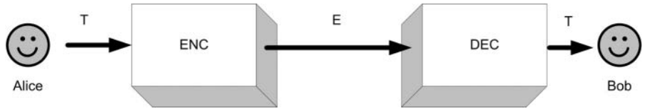
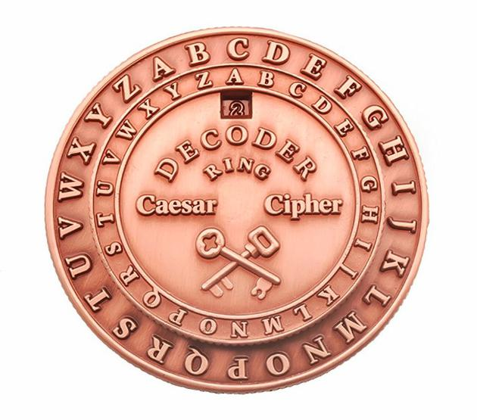
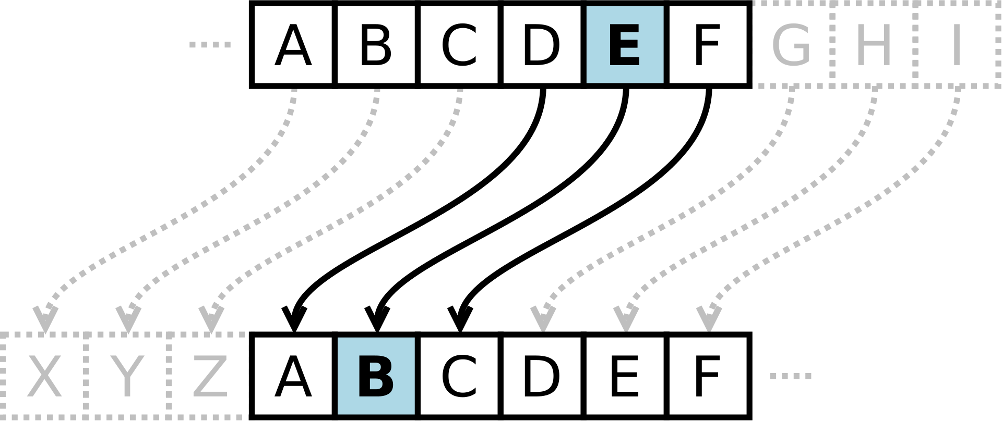
plaintext
ciphertext
plaintext
sender
receiver

Slide 5
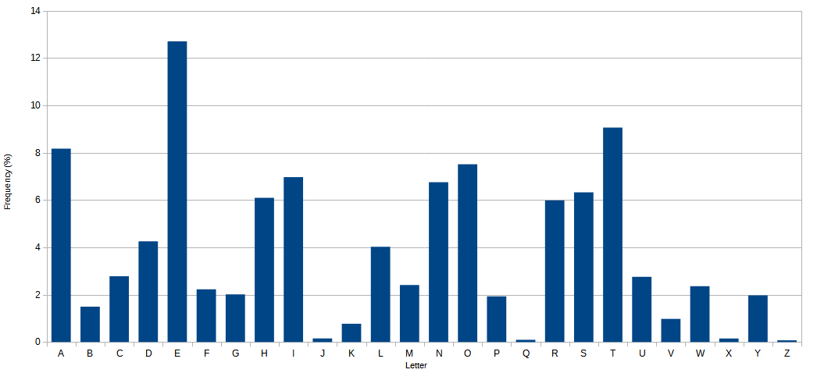

Slide 6
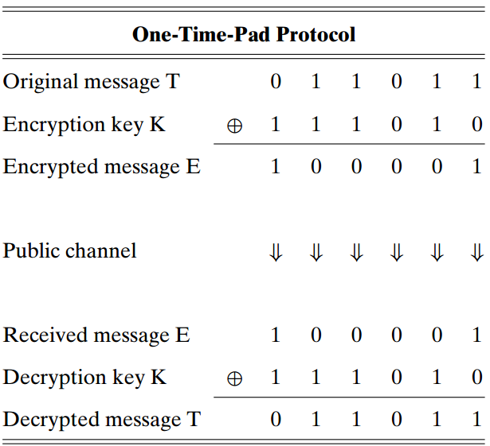

Slide 7
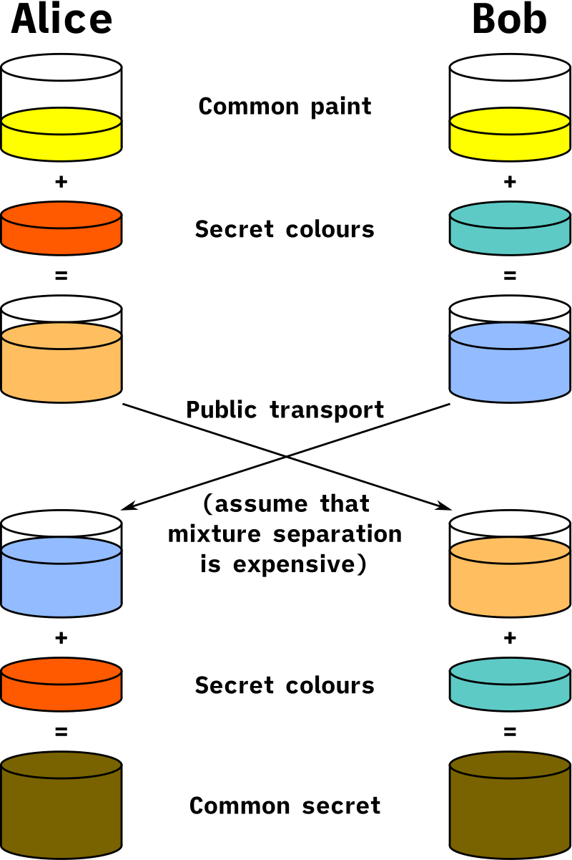
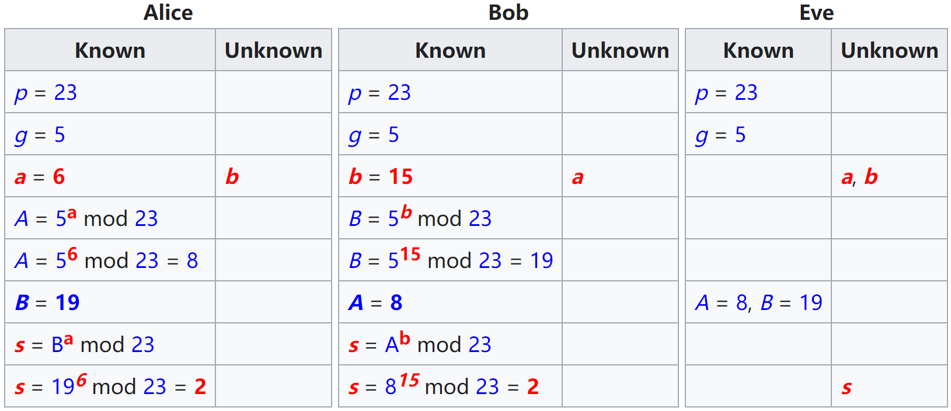

Slide 8
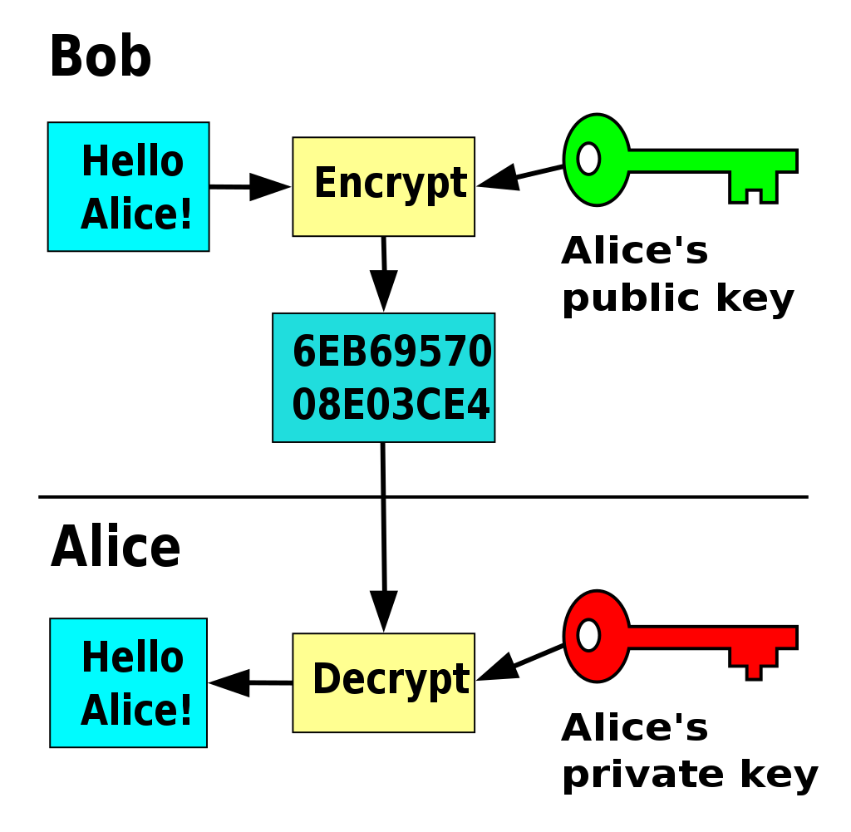
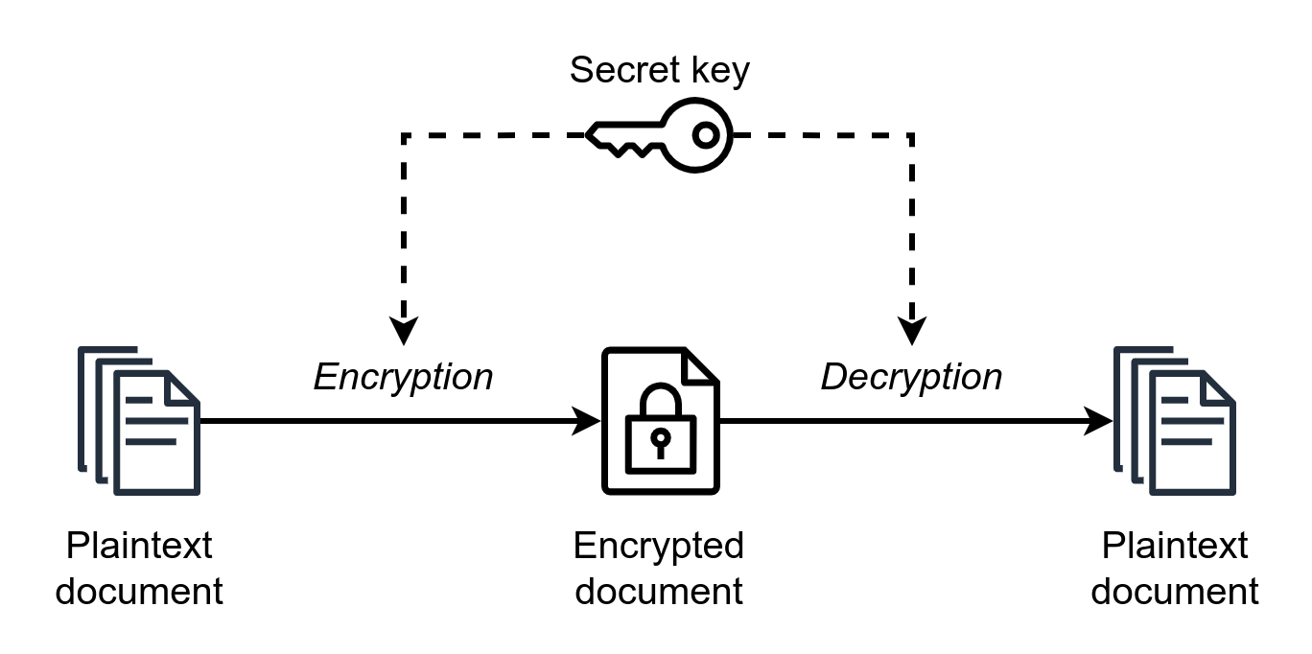

Slide 10
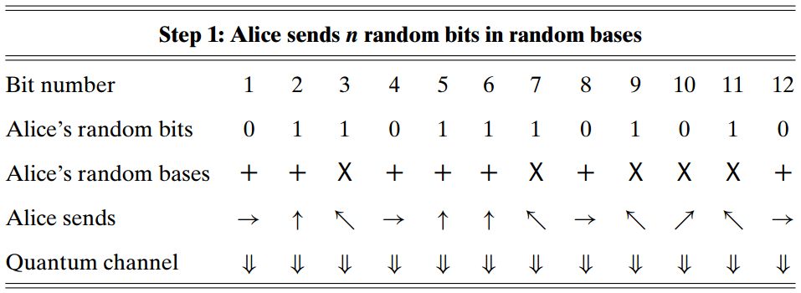
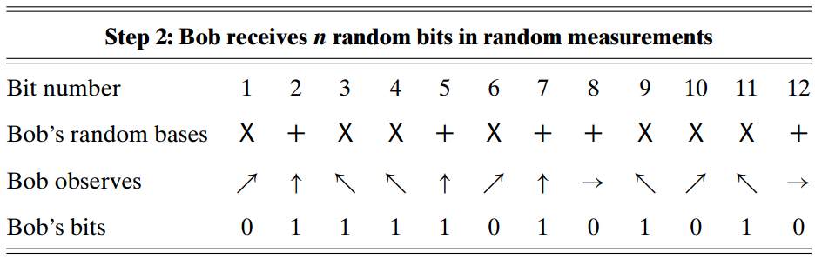

Slide 11
Case 2: Eve gets incorrect bits
Bob uses the same base as Eve (definitely wrong)
Case 1: Eve gets correct bits and Bob too
Bob uses different base as Eve

Slide 12
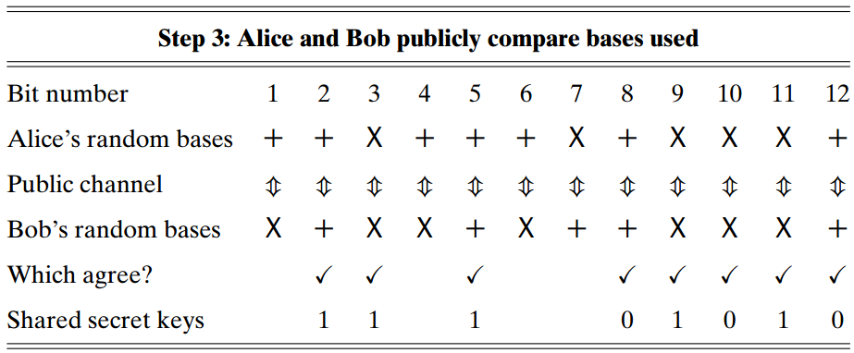
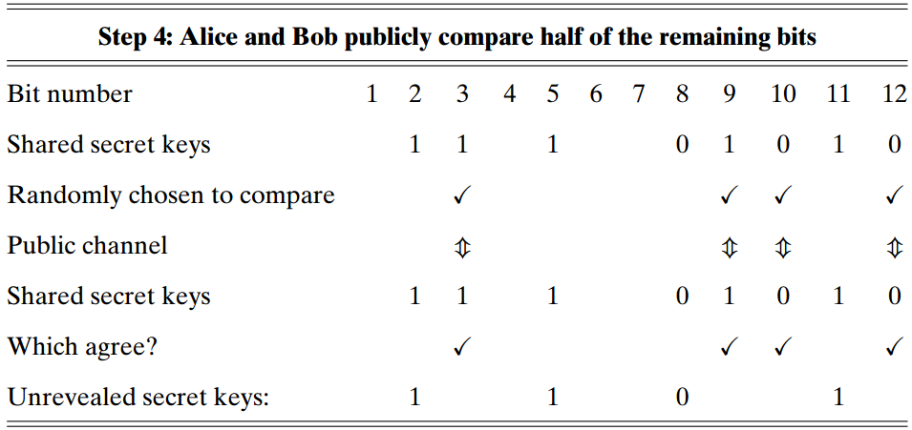

Slide 13
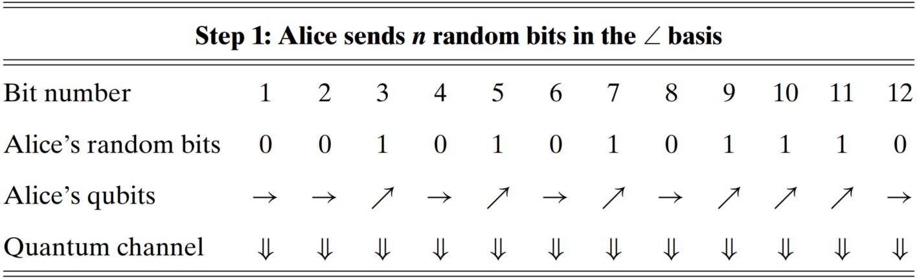

Slide 14
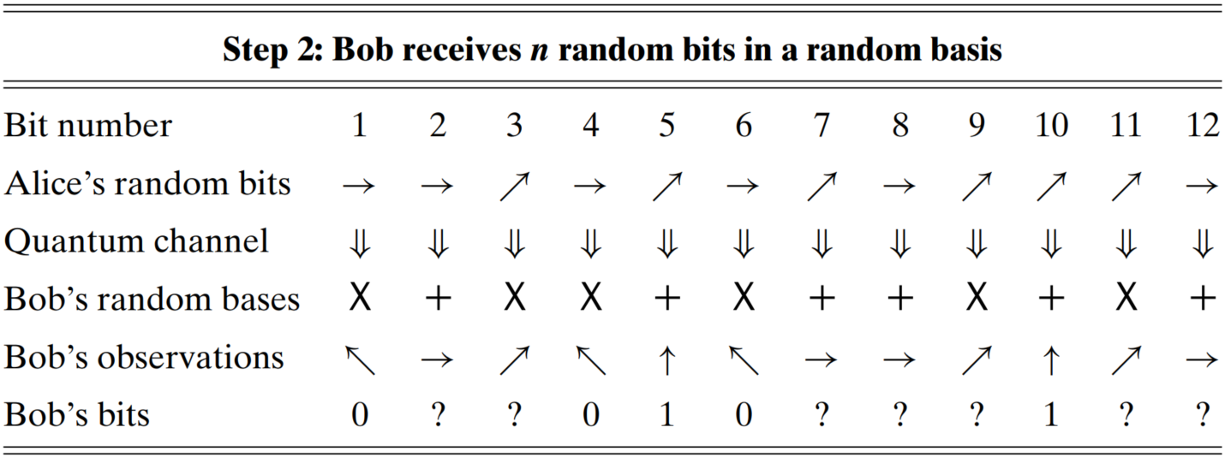

Slide 15
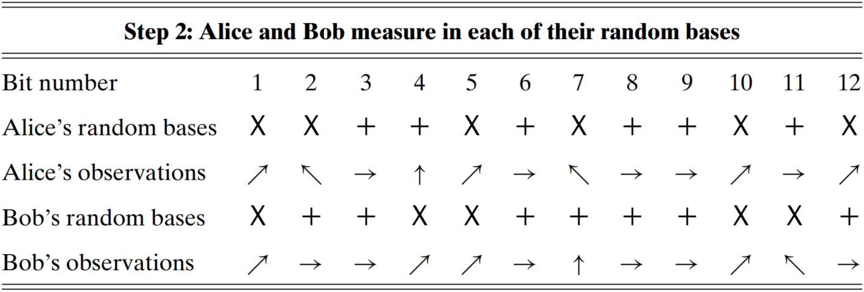

Slide 16
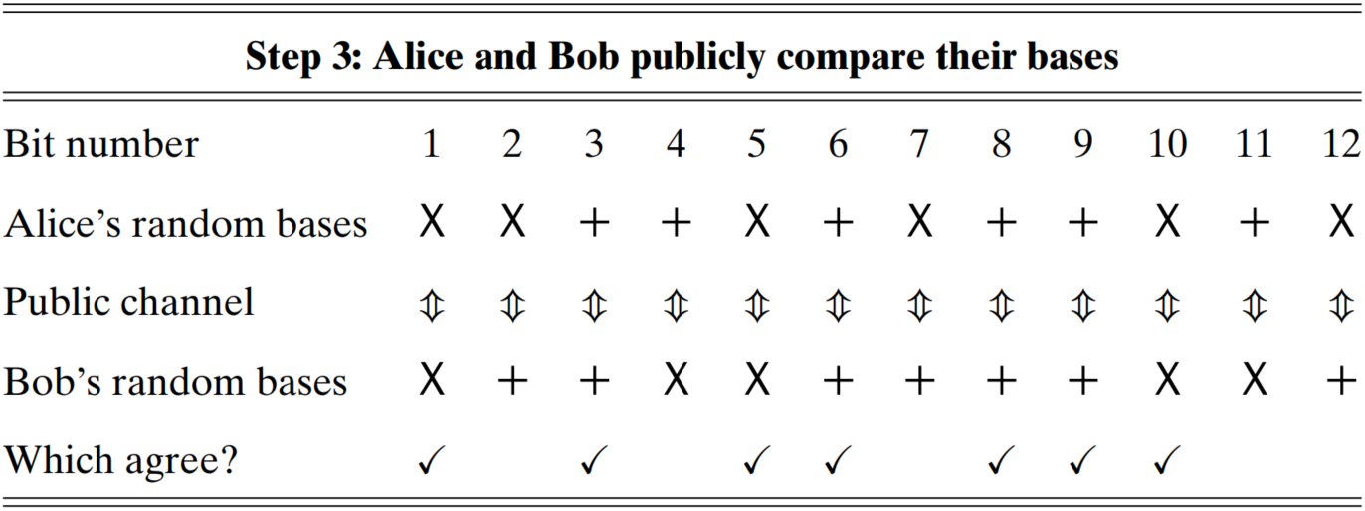

Slide 18
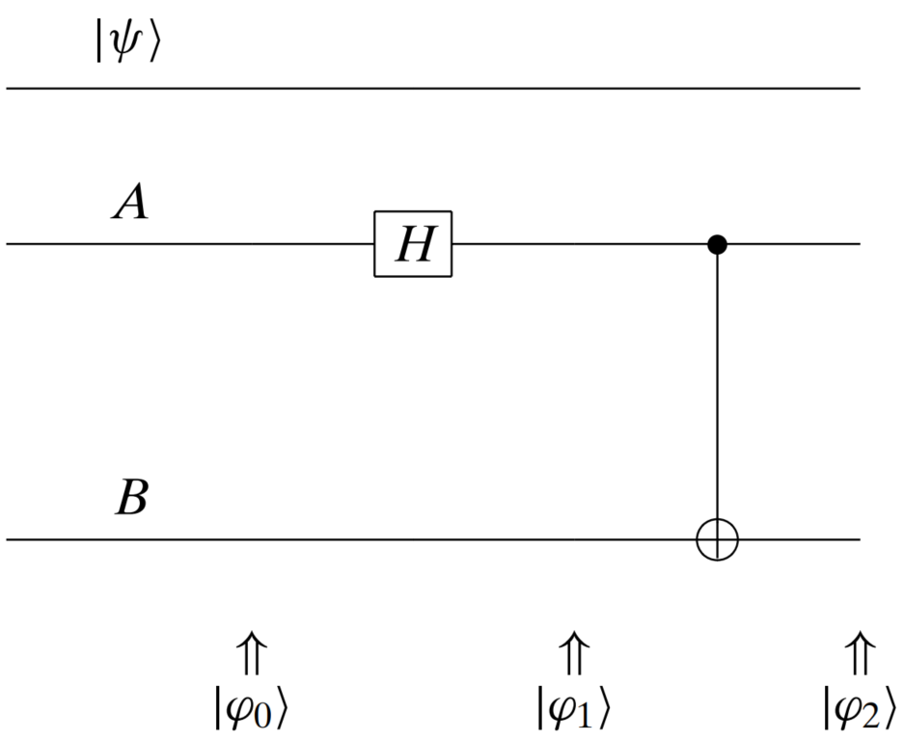
H

Slide 19
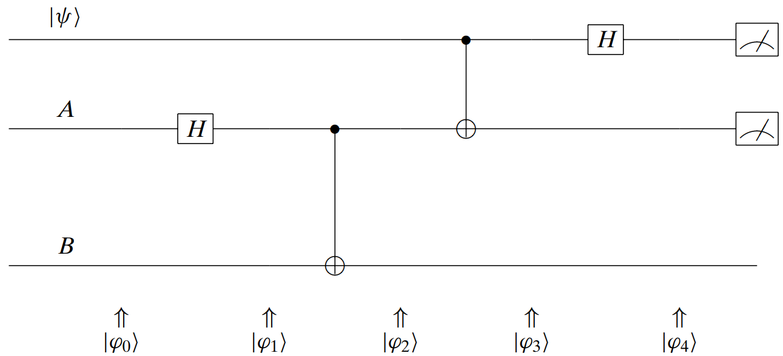

Slide 20
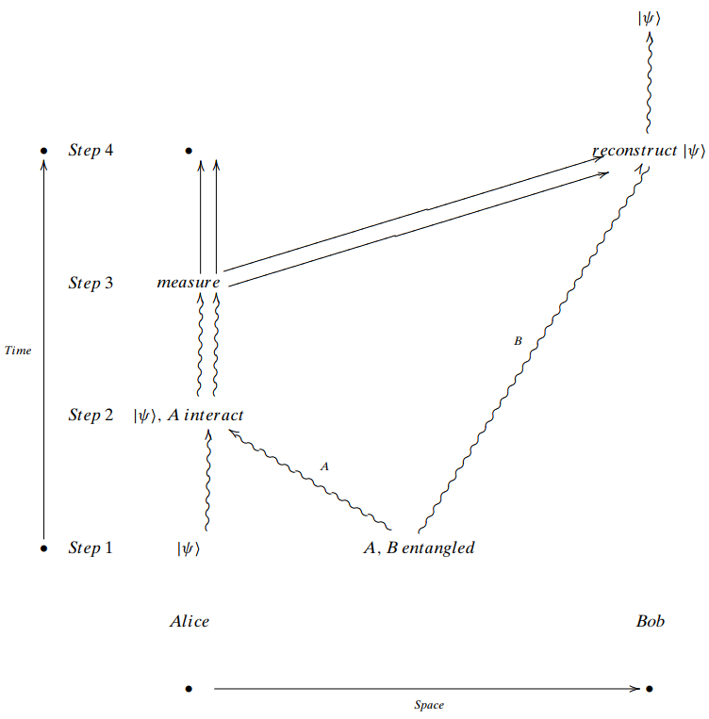

Slide 21
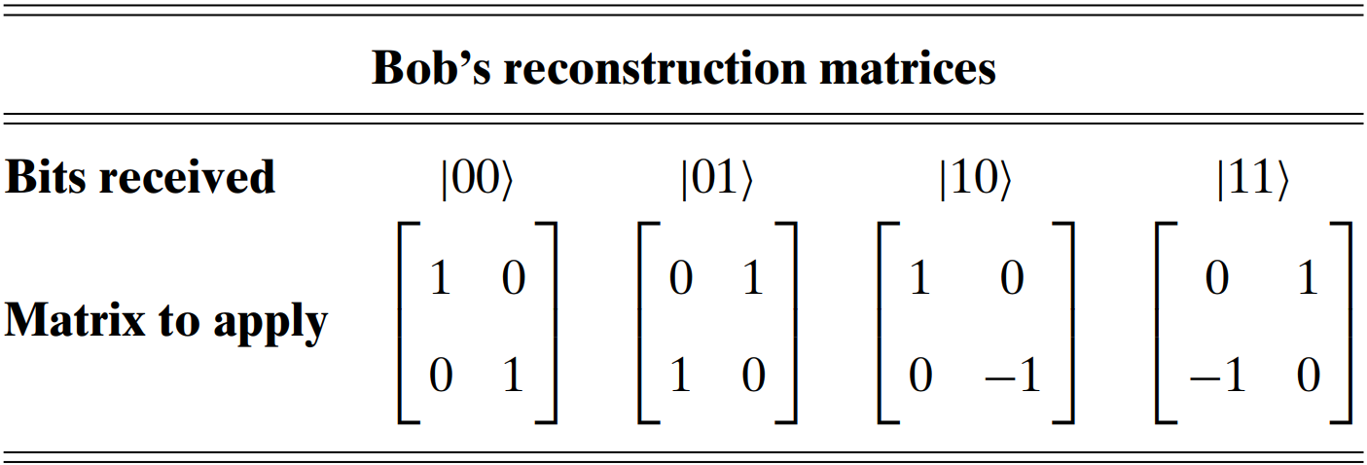

Slide 22
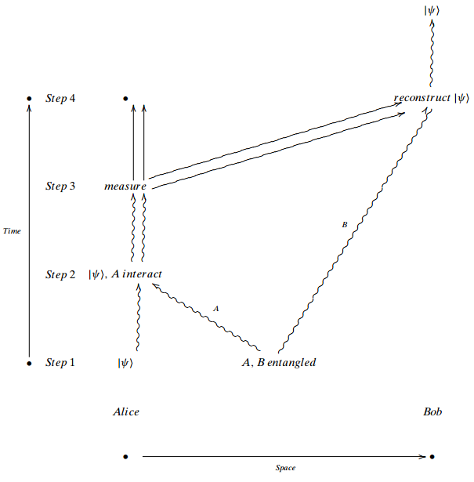
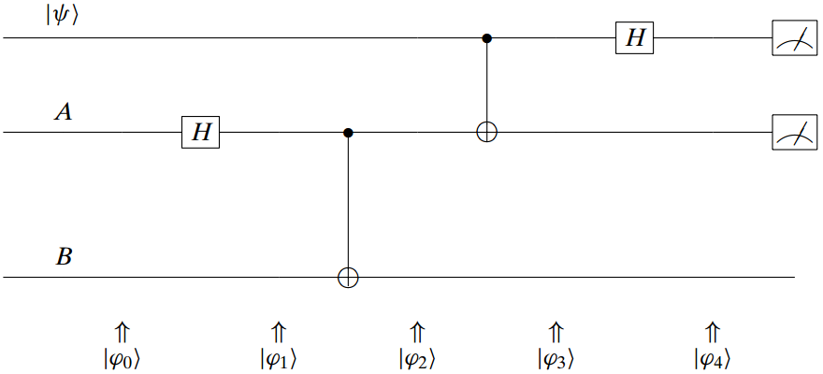
Bob transforms his quantum bits accordingly to Alice's observations
Alice conducts observation on her two quantum bits
Alice controls A with target quantum bits
Prepare two entangled qubits A and B

Slide 24
 | Single (qu)bit | Double (qu)bits | Eight (qu)bits / (qu)byte
Classic bit(s)
Quantum bit(s)

Slide 25
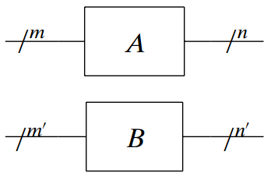
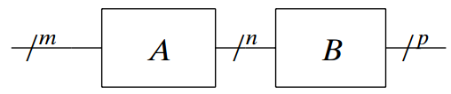
gate
input
output
m
A
n
m
A
n
B
p
m’
B
n’

Slide 26
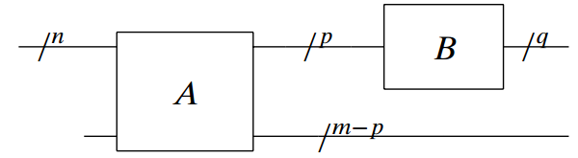
A
p
B
q
n
m-p

